Slide 1

Lesson 1: Introduction

Slide 2


Slide 3
Lesson plan:
Self introduction
Teacher vs Mentor
Study plan
Java Core
Java for Web
Online\Offline lessons
Homework
Programming technologies
Q&A

Slide 4
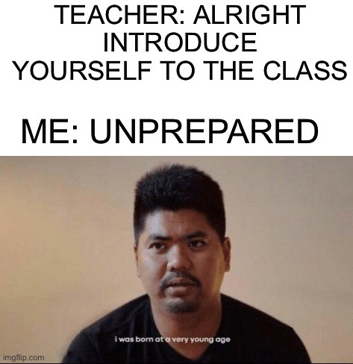
Introduction
Name
Goals and expectations
Something about yourself

Slide 5
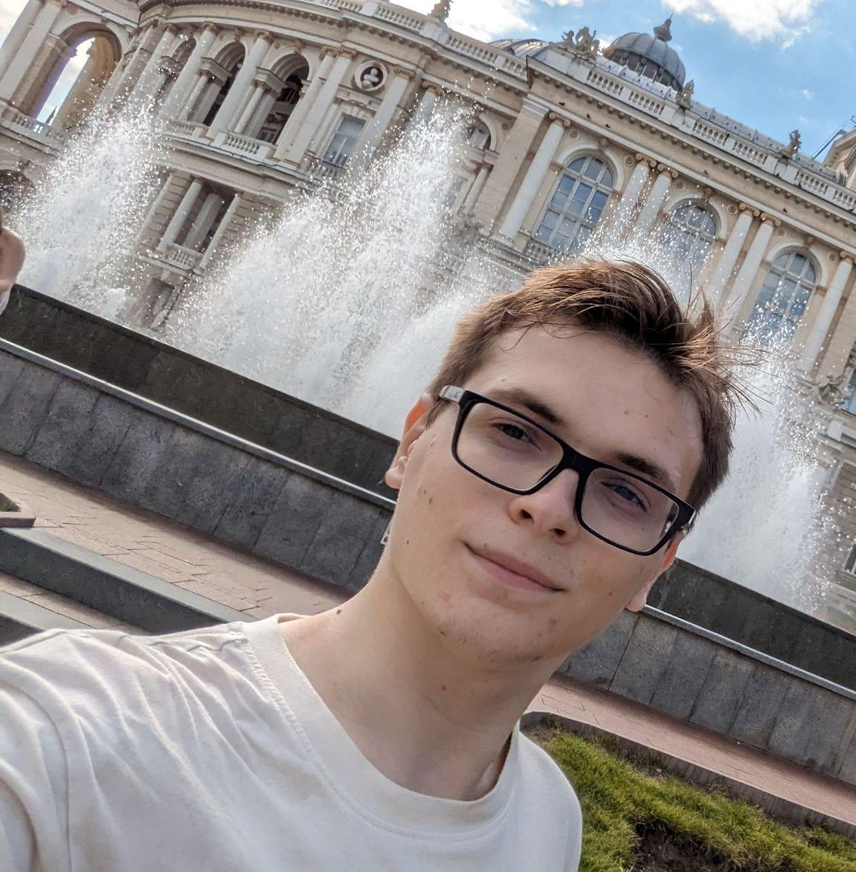
Vladyslav Nikolenko
GeekHub 9 graduate
GeekHub 11-13 mentor
3 years of working experience in Java
I'm a huge fan of retro games. Sonic is better than Mario IMHO
My favorite anime is "Grimgar of Fantasy and Ash." I have 19 light novels (plus 2 side stories) in English

Slide 6
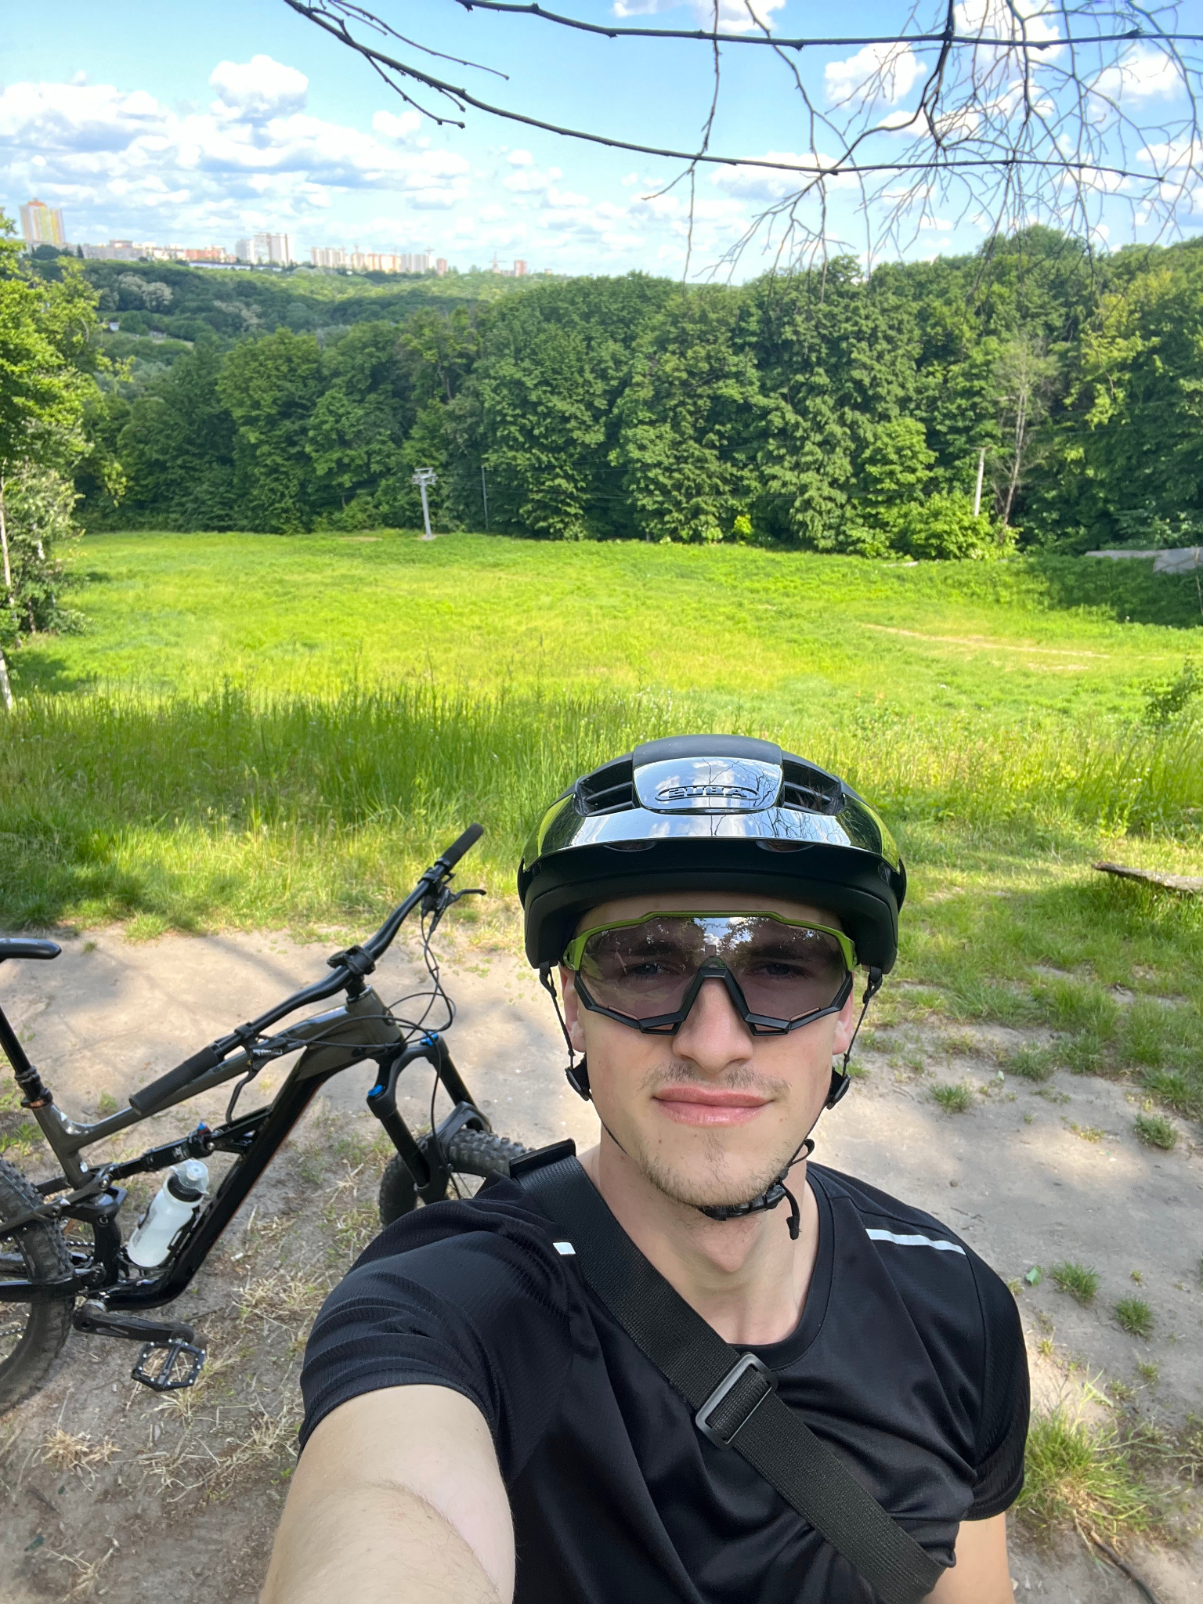
Misha Semitkin
GeekHub X graduate
First time on GeekHub as a mentor
Java dev
Student
Mountainbiker

Slide 7

Nazar Onishchenko
GeekHub 9 graduate
First time on GeekHub as a mentor
Work 3+ years in SPD Technology
Ping Pong, Gym, Gaming
Kotlin, Java

Slide 8

Vadym Myroshnyk
Work 3+ years in SPD Technology
Tourism, mountains, active lifestyle
Java, JS

Slide 9

Yarosláv Brahinets
GeekHub 3 graduate
Mentoring at GeekHub 7th season in a row
Lifelong learner and security enthusiast
Nerdish alumni of Java for Web.
Passionated runner. Find me on Strava
Coding with enjoy since 2014
Engineering Manager at SPD Technology

Slide 10

Vasya Rudas
GeekHub 3 graduate
Mentoring at GeekHub 8th season in a row
Work 8+ years in SPD-Ukraine
Fan of Intellij IDEA and Kotlin language
Follow TDD and Clean Code principles
Retro/Indie Gamer 👾
Learn DJ-ing and Music Production as a hobby

Slide 11



Lector Assistants
Andrii Yeromenko
Serhii Kuzin
Andrew Bereza

Slide 12


Slide 13
Teacher vs Mentor

Slide 14
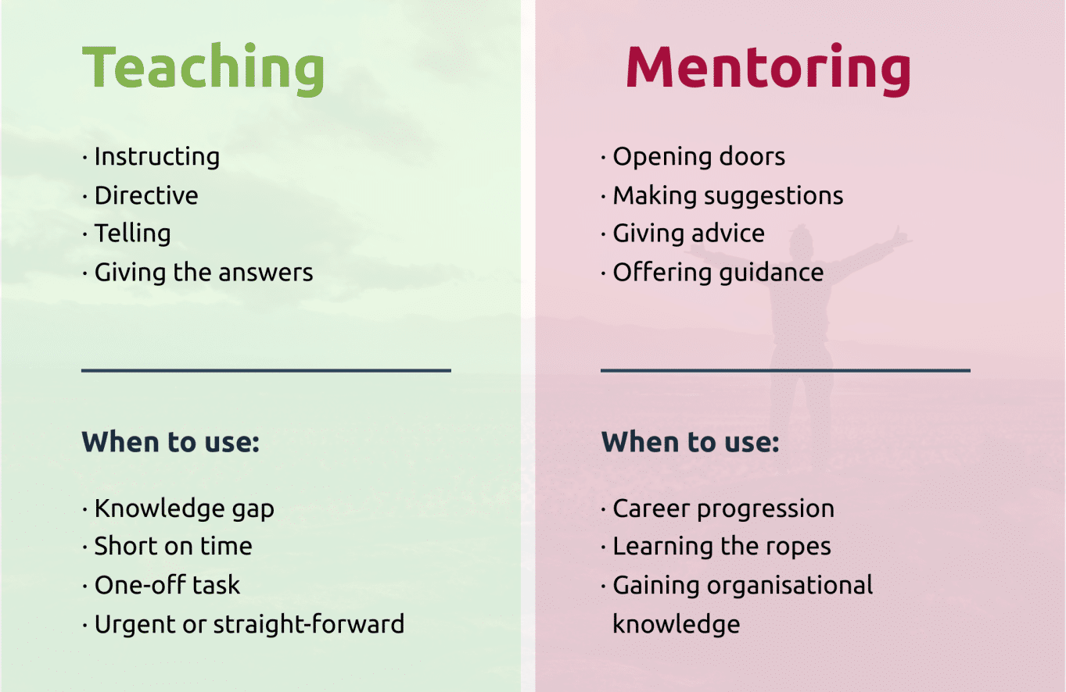
Teacher vs Mentor

Slide 15

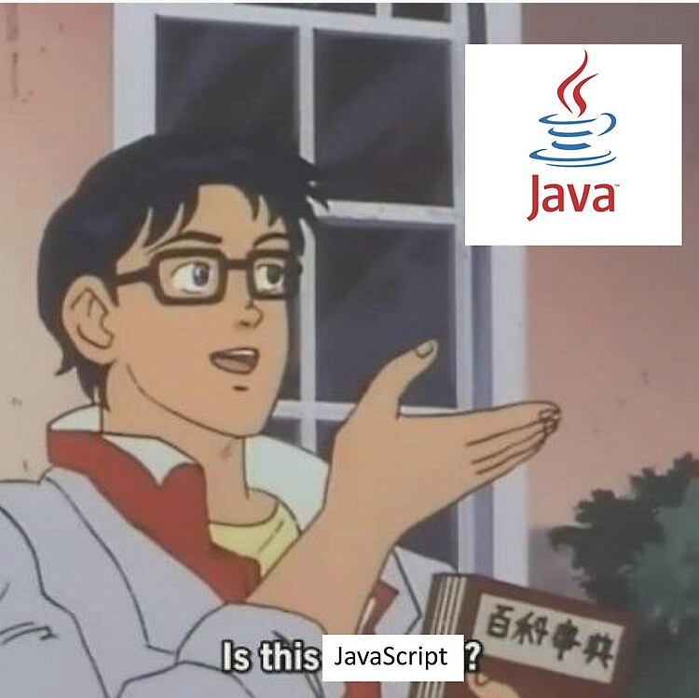
Study Plan: Java Core
Introduction
Basics
Object-oriented Programming
Generics. Collections Framework
Error Propagation and Handling, Input/Output
Unit Testing, Mocks
Functional Programming, Optional, Stream API
Concurrency
Reflection
Software Craftsmanship
*Practice can be added or removed on the fly

Slide 16


Study Plan: Java for Web
Gradle
Spring IoC
JDBC, Spring JDBC, Flyway
CI/CD
Spring MVC, Boot
Front End
REST, Swagger
Microservices
Spring Security part 1&2
Integration Testing
Docker
Hexagonal Architecture
*Practice can be added or removed on the fly

Slide 17
Lessons
Each lesson will be on Tuesday at 18:30;
All lessons can be visited online;
All lessons have homework;
In case of any situation, we will switch to fully online lessons with recordings;
During the course, we will have several practice lessons in which we will cover topics that students find challenging and do live coding;
Practice doesn’t have any homework. Use the knowledge you gain on the practice and your free time to improve your code quality.
At the end of the course, we will have a coursework that will demonstrate what you have learned. Details will be provided after the holidays;

Slide 18
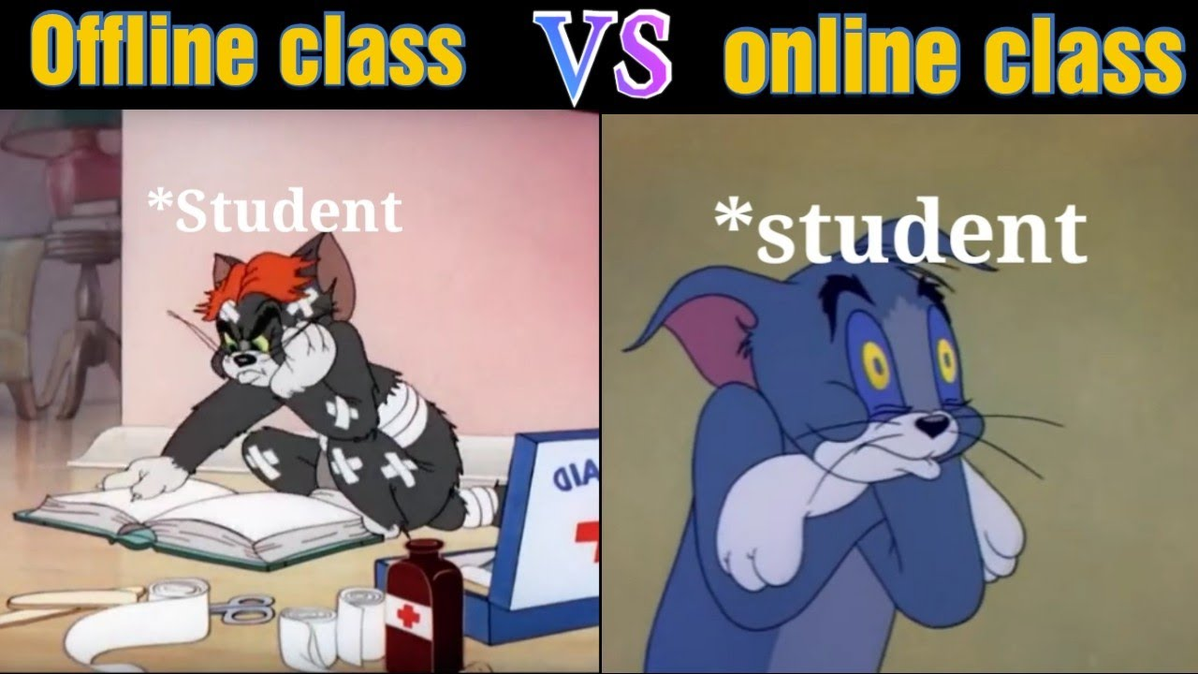
Why Offline is better?
Ability to ask additional questions after the lecture
Better communication with lecturer
Better focus
Better sound

Slide 19


Homework
After each lesson you will get a homework;
Every homework has a deadline until Sunday;
Each homework is reviewed by the random lecturer;
After review, lecturer gives feedback that you need to apply to your homework;
Before you finish and apply all of the homework review recommendations, you cannot move on to the next homework;
Each homework is graded by the teacher;
If a student has two failed homeworks in a row, he will be expelled;
Homework that wasn't done on time will not be reviewed.

Slide 20
Homework types
Java Core | Java for Web
Every homework task will be dedicated only to specific topic and code will not be related on previous homeworks | Every homework task related to each other and as a final result we will get an fully functional project

Slide 21

Homework quality control
Code is formatted
Code is organized
Code is verified
Tools that can help:
CheckStyle
EditorConfig
SonarLint

Slide 22

Good coding practices
Java Code Convention: by Google, by Oracle
Clean code principles
40 Tips that will change your coding skills forever
Developers jargon
Books:
“Clean Code” and other by Robert Martin
“Java: The Complete Reference” by Herbert Schildt

Slide 23
Questions & Answers
“Asking questions is a good way to learn more”
@Some smart man

Slide 24
Questions & Answers
“Always try to search by yourself before asking for help”
@Even smarter man

Slide 25
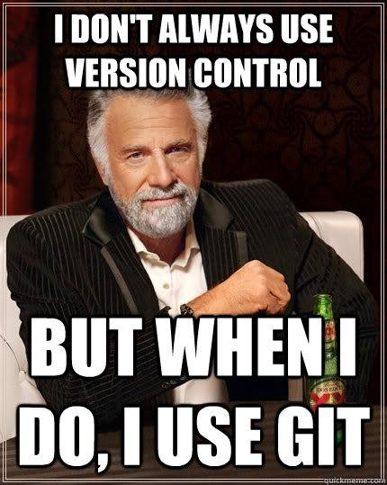
Version Control
Version control, also known as source control, is the practice of tracking and managing changes to software code.
Version control systems are software tools that help software teams manage changes to source code over time.

Slide 26

Programming technologies: Git
“Git is free and open source software for distributed version control: tracking changes in any set of files, usually used for coordinating work among programmers collaboratively developing source code during software development.”
@Wikipedia
Download Git from the official website or GitHub instruction.

Slide 27
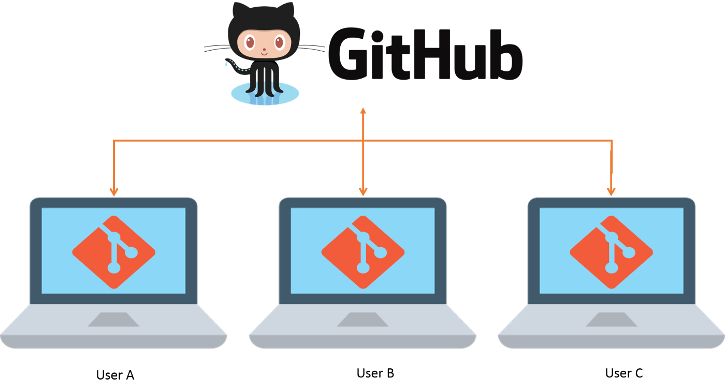

Programming technologies: GitHub
“GitHub is an online software development platform used for storing, tracking, and collaborating on software projects. It enables developers to upload their own code files and to collaborate with fellow developers on open-source projects.”
@HubSpot

Slide 28
Student GitHub account
Go to the github page and register new account. Your student account should match following rules:
Account should be registered on your real name.
Use your full name as nickname for your account
Upload your photo (same as for slack) as avatar

Slide 29
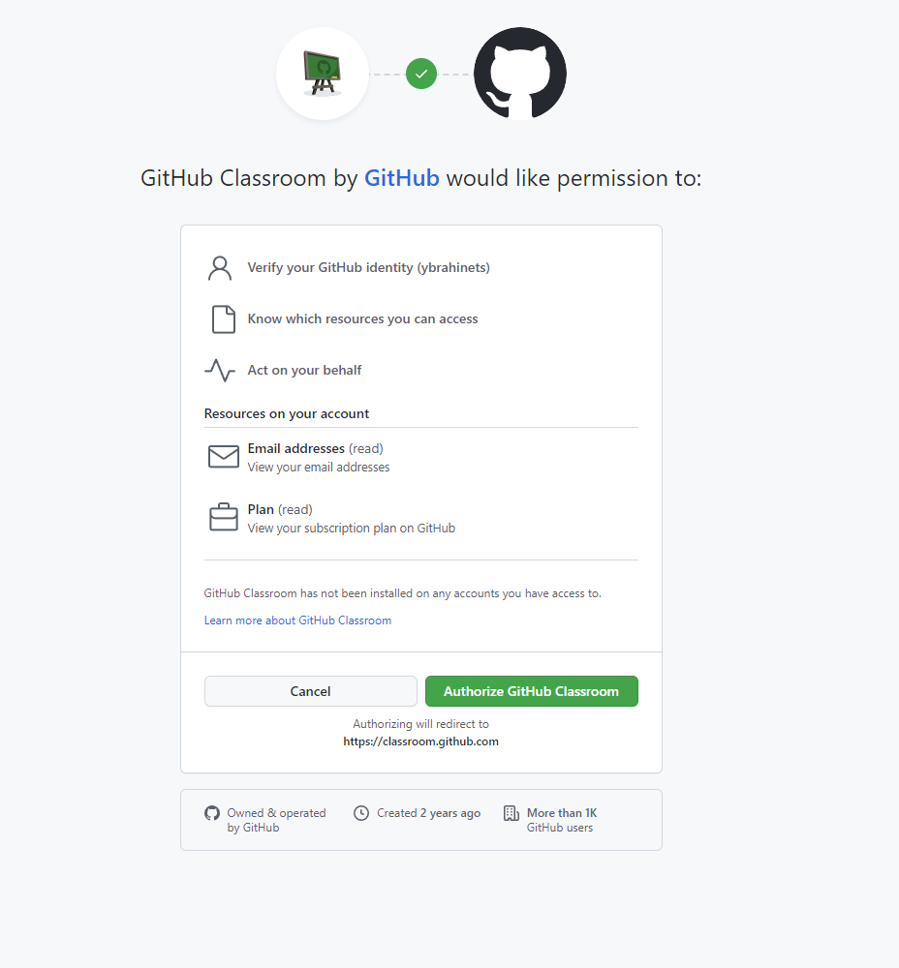
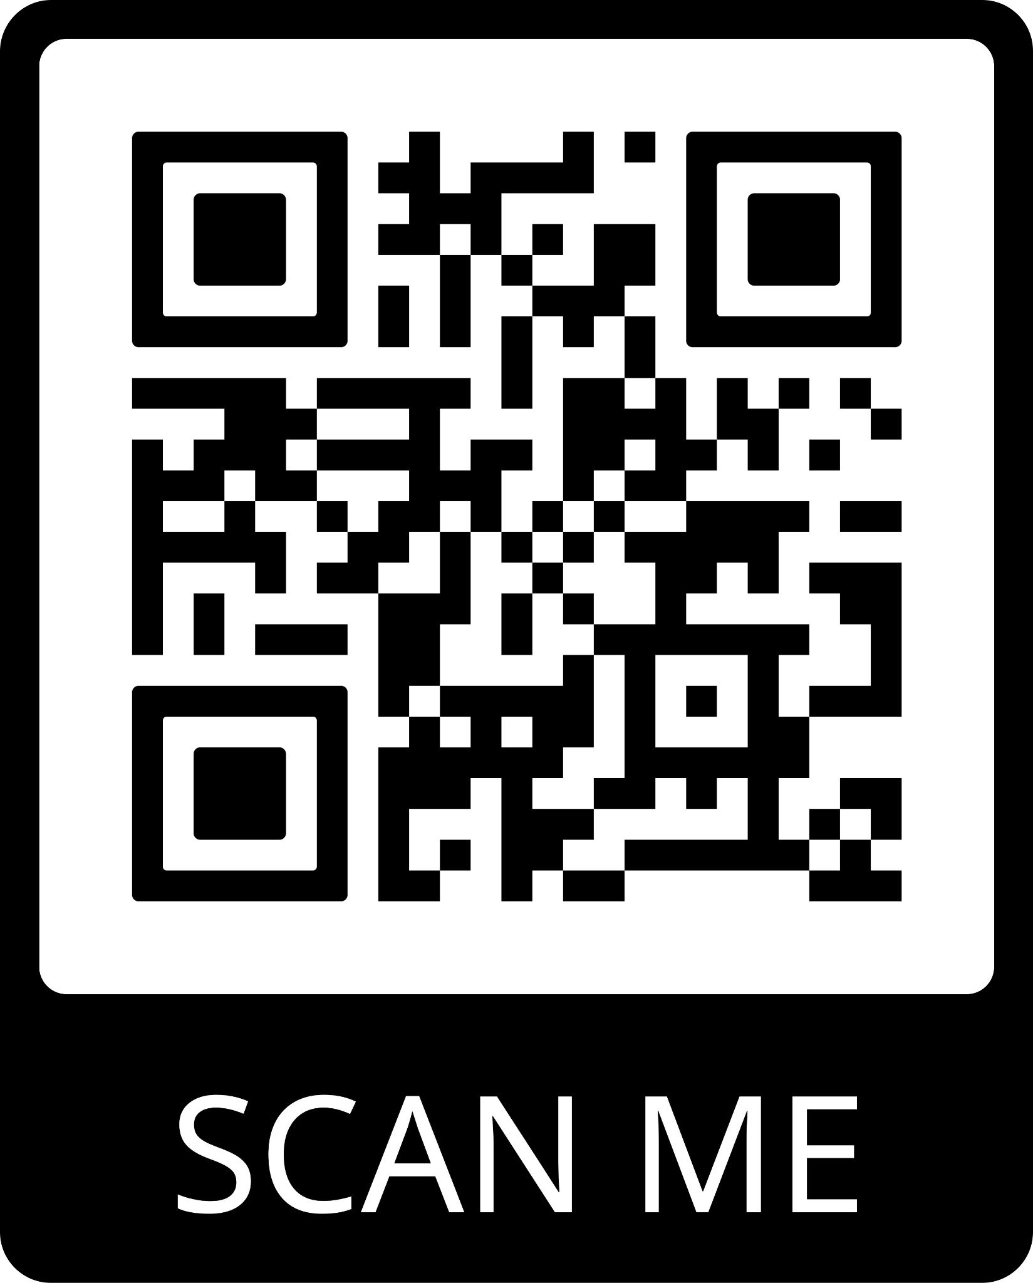
GitHub classroom
You can join GeekHub via link or QR code:

Slide 30
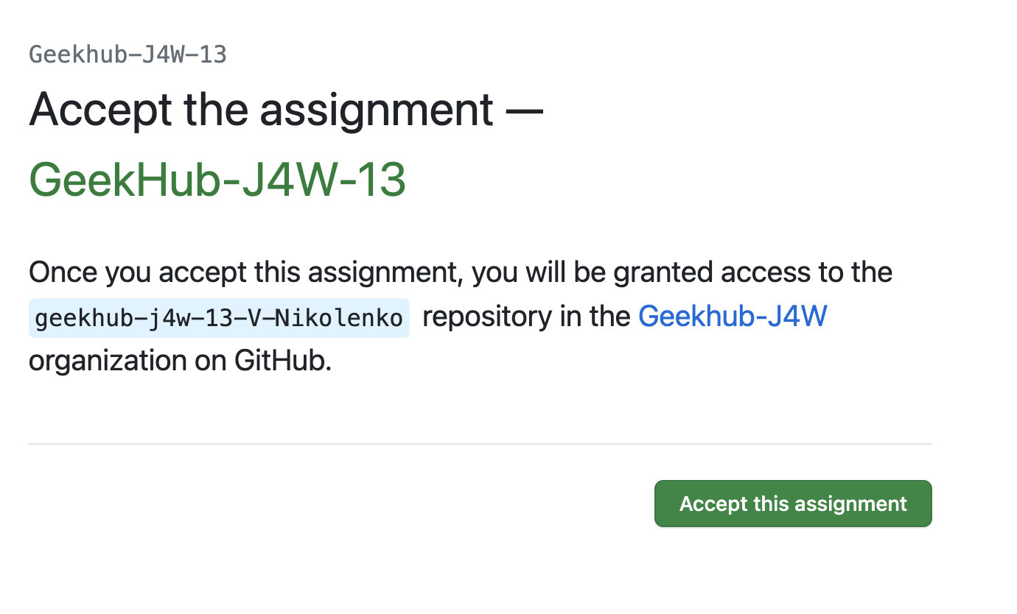
Join GitHub classroom

Slide 31
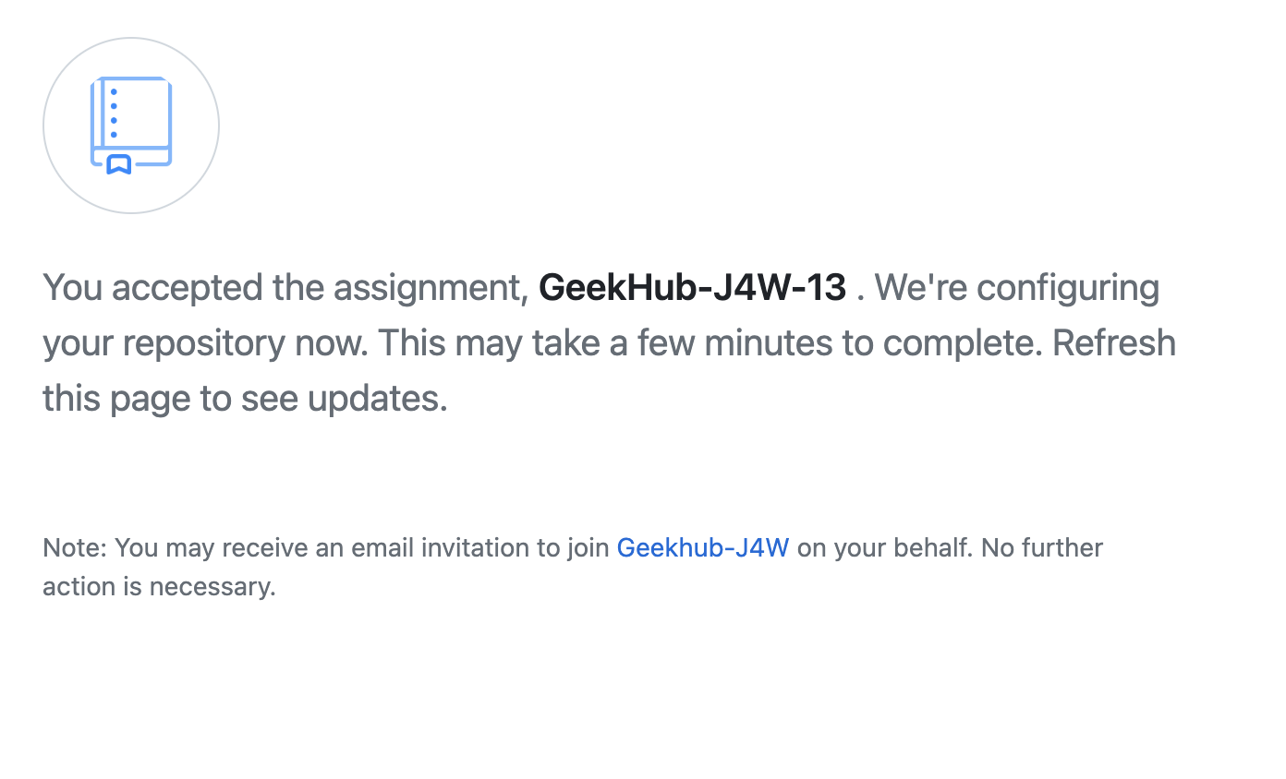
Join GitHub classroom

Slide 32
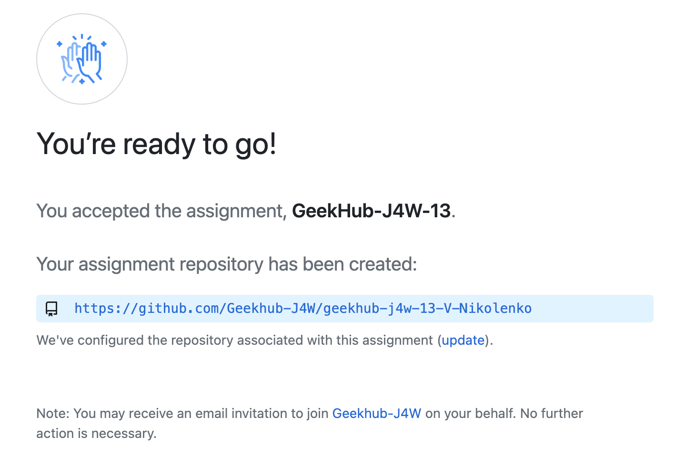
Join GitHub classroom

Slide 33
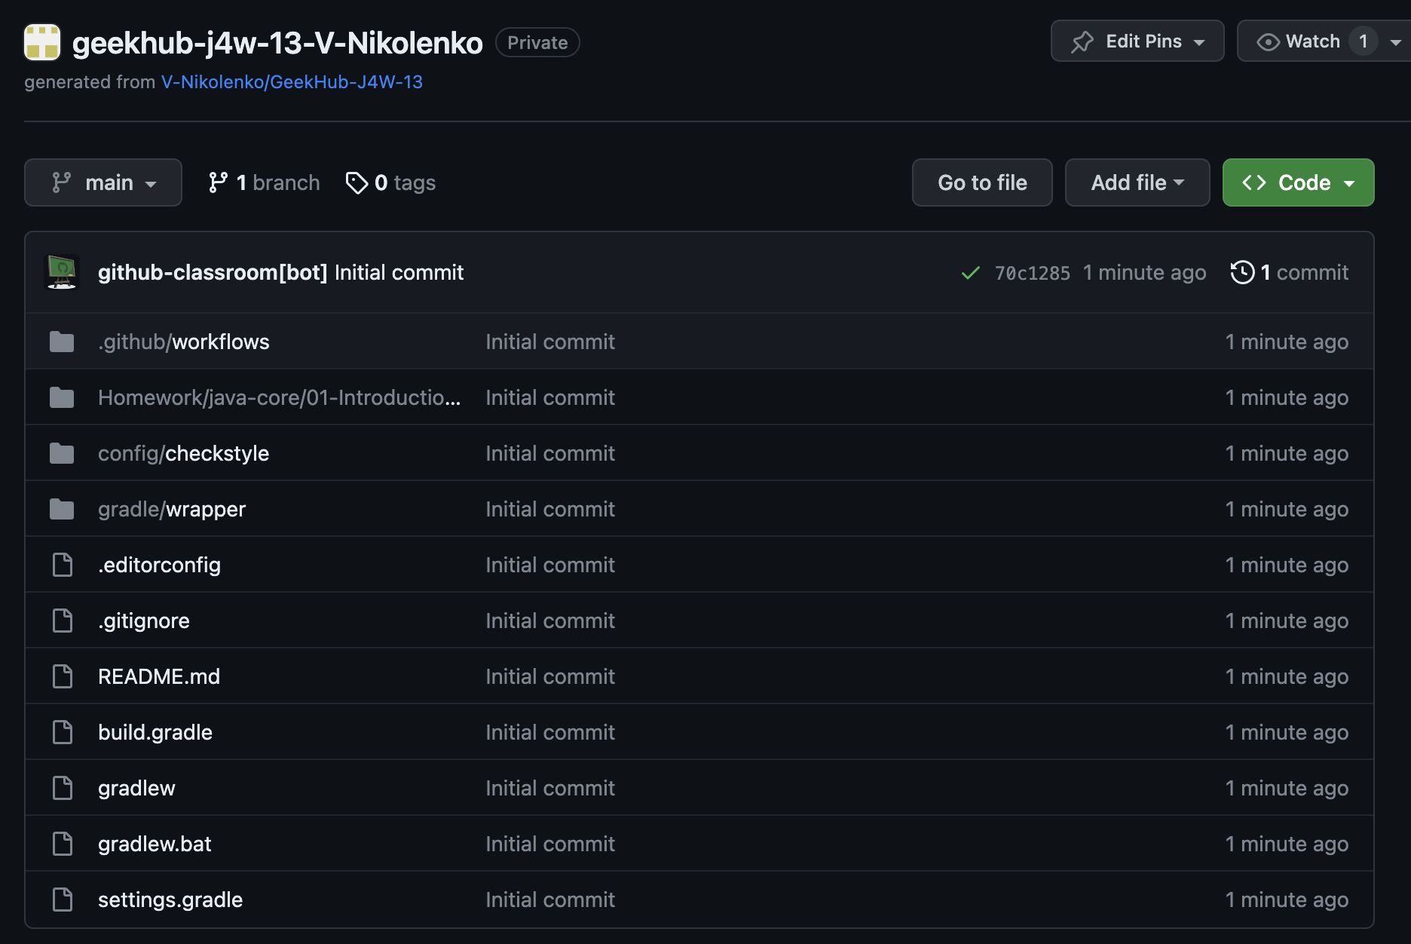
Join GitHub classroom

Slide 34
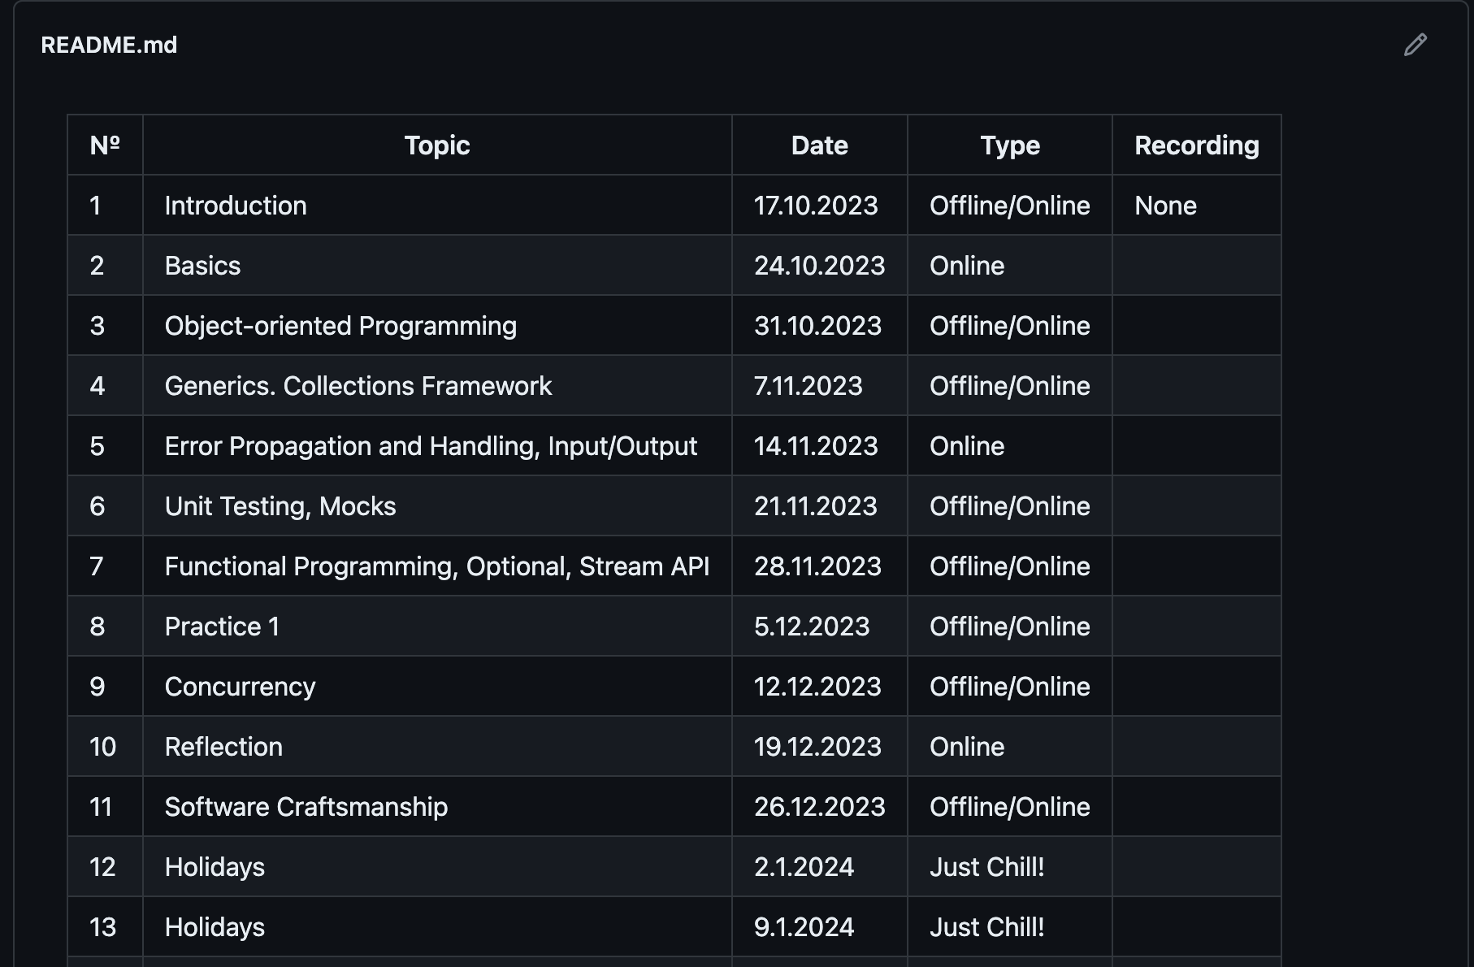
Join GitHub classroom

Slide 35
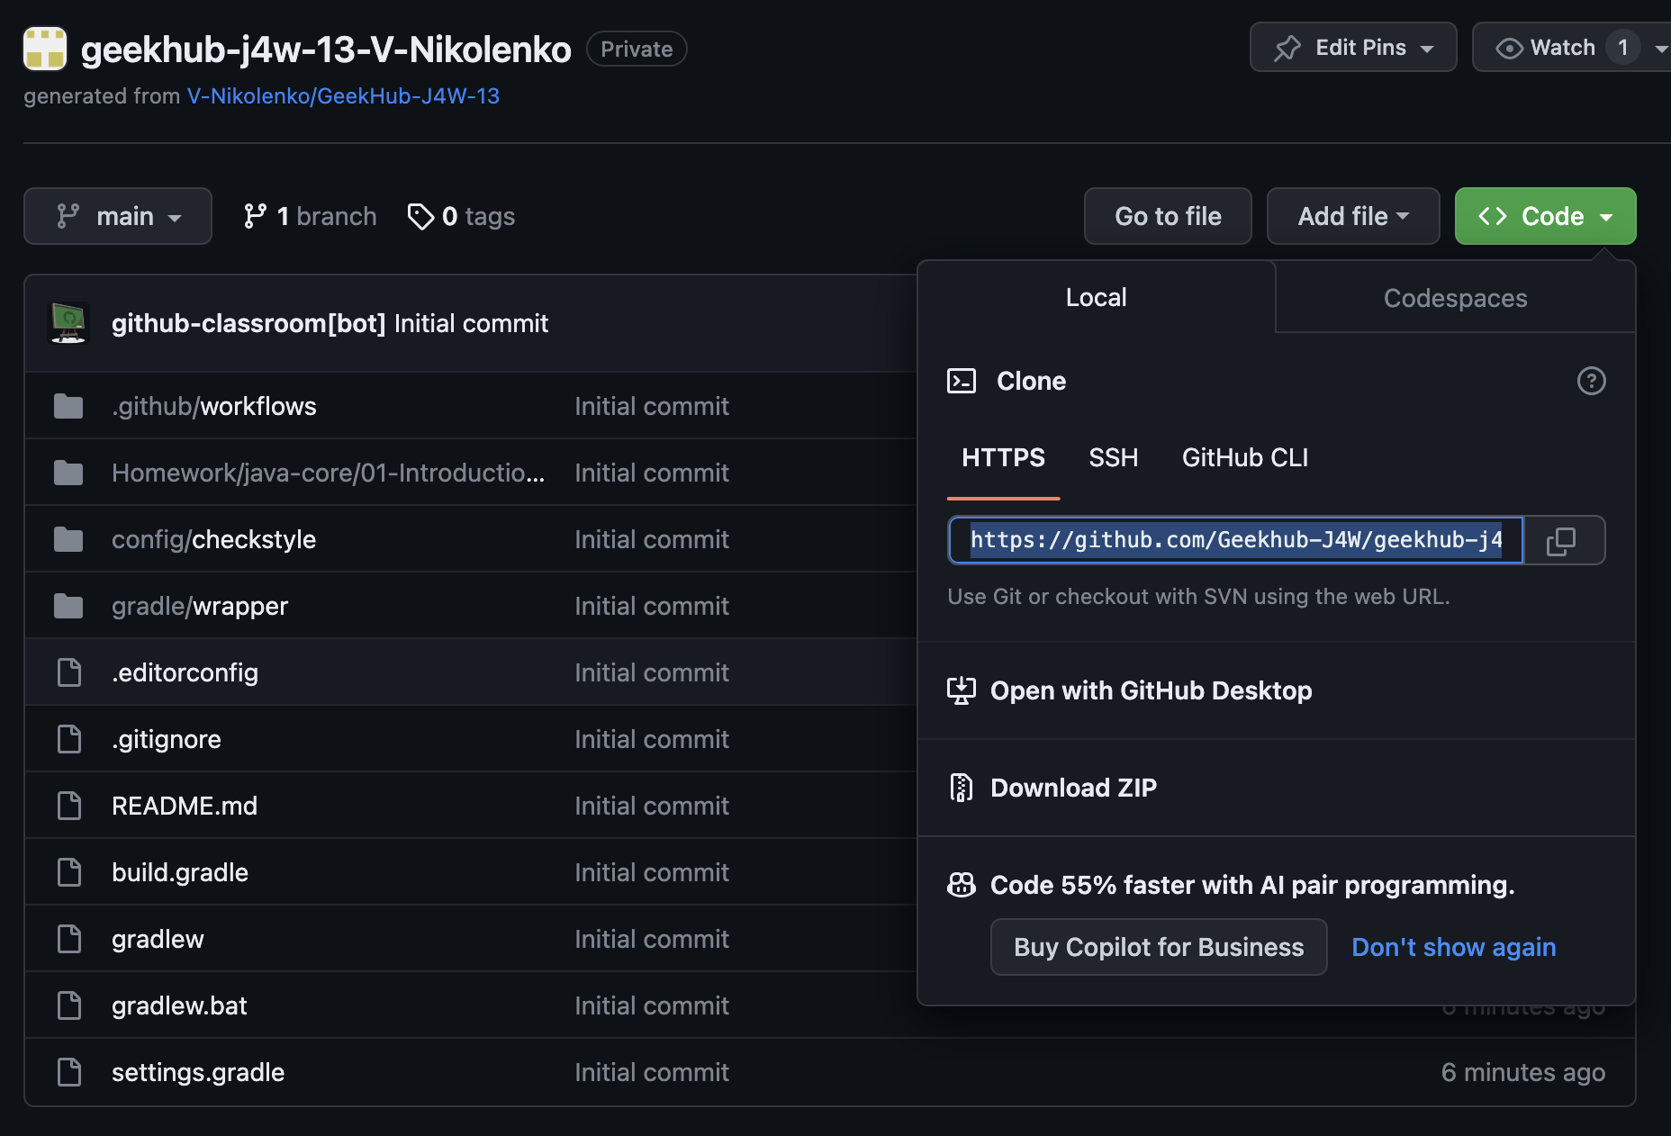
Join GitHub classroom

Slide 36
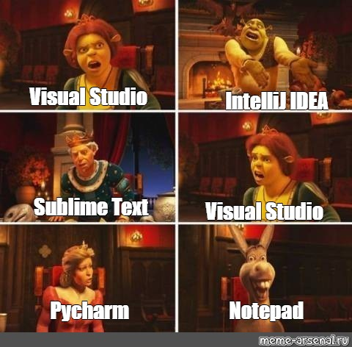
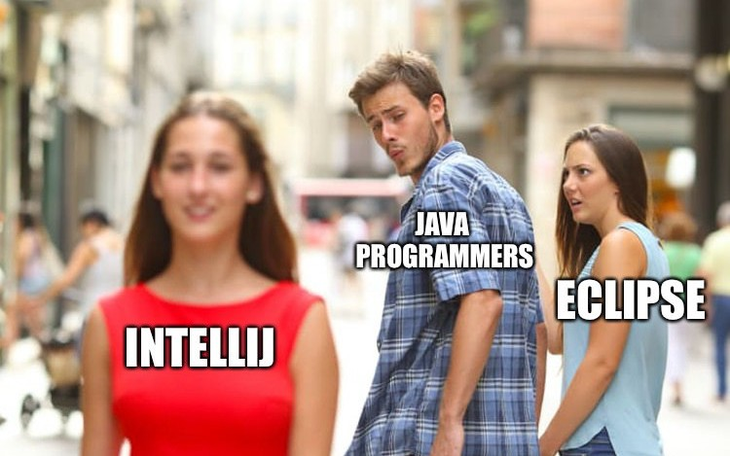
Intellij IDEA
Download Intellij IDEA Community from official website.

Slide 37
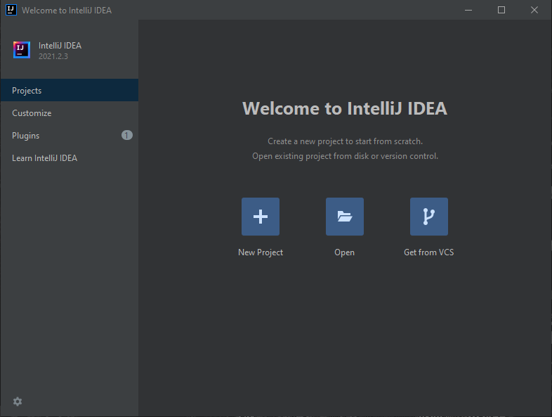
Import project into IDEA
Open IntelliJ IDEA
Choose “Get from VCS”
Choose “Git”

Slide 38
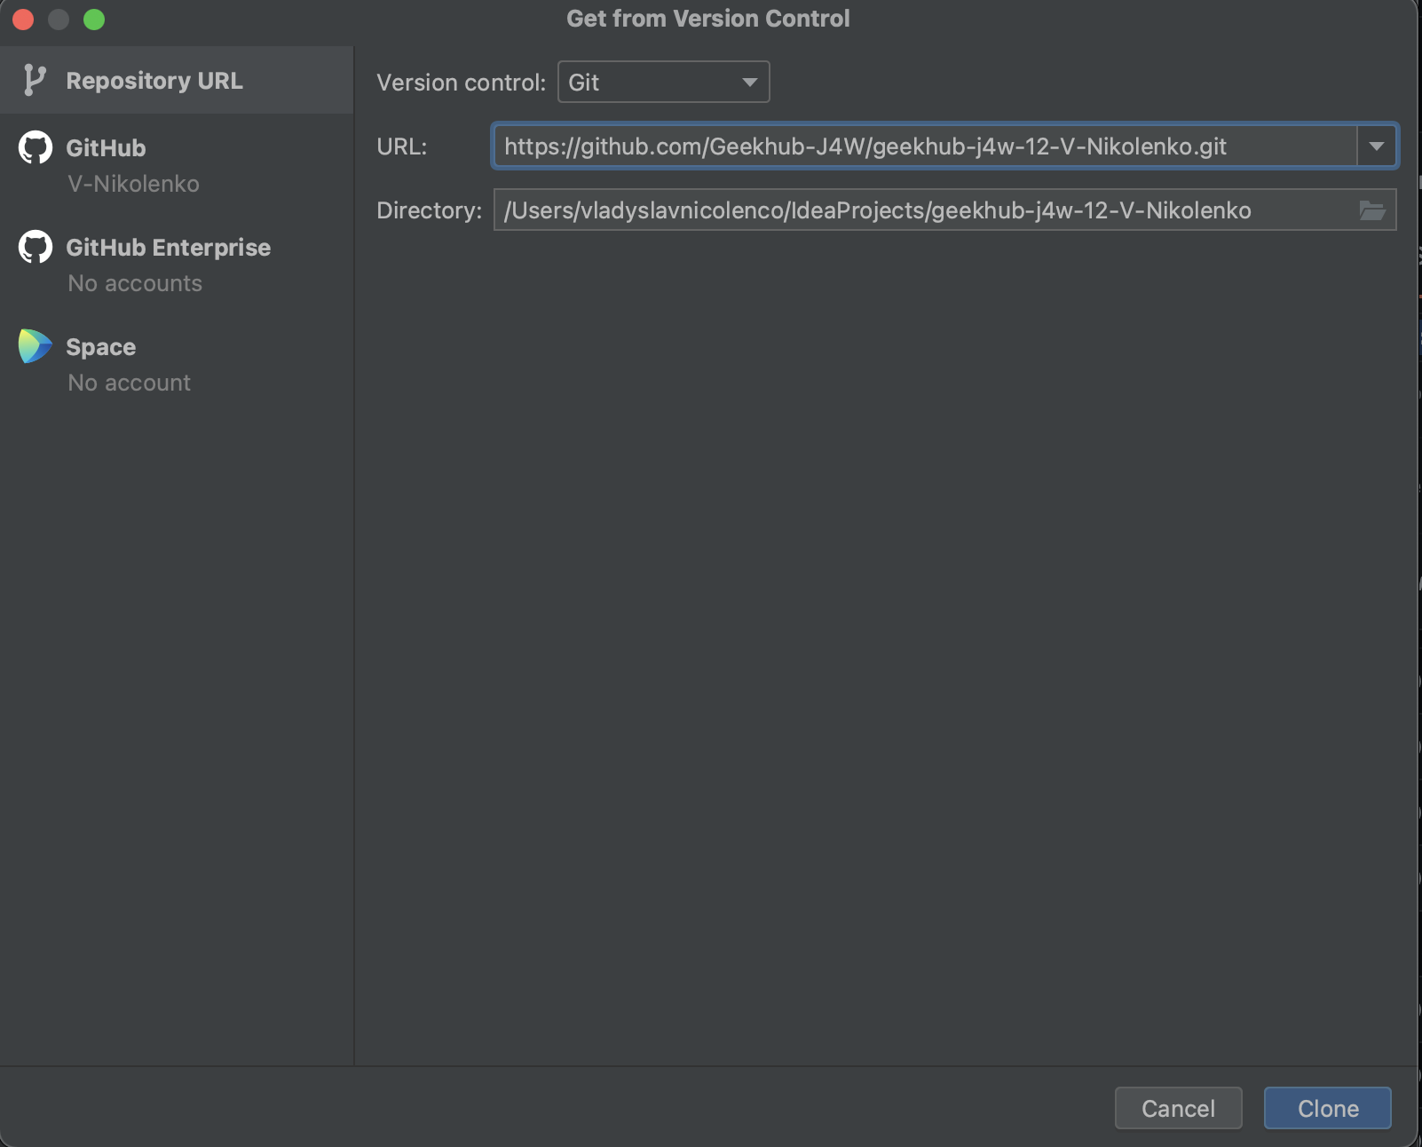
Import project into IDEA
4. Paste copied link of the repository into just opened window
5. Click “Clone”

Slide 39
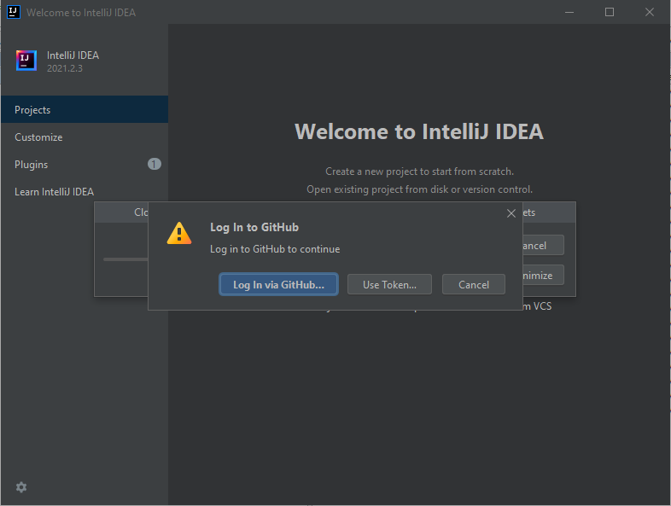
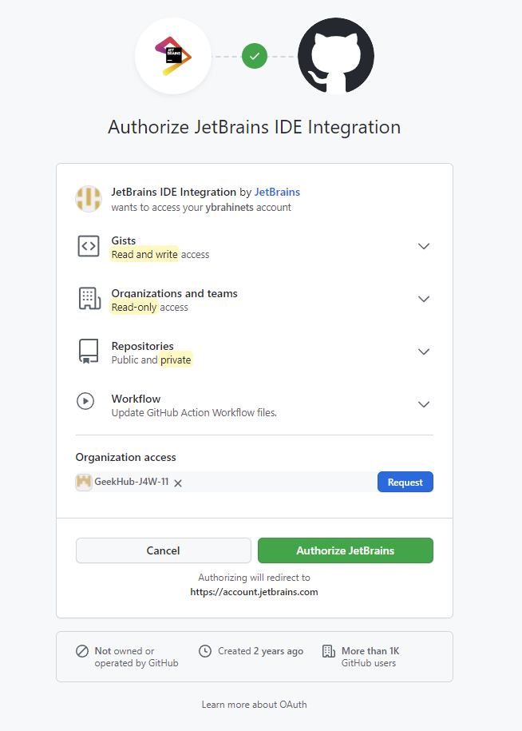
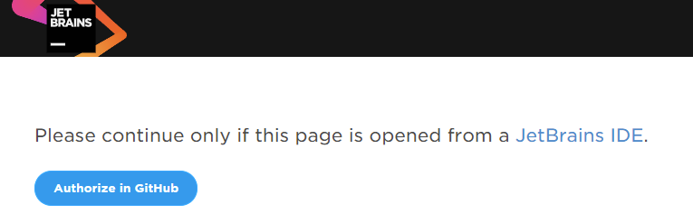
Import project into IDEA
6. Input your login and password (or token) for
GitHub.com if required

Slide 40
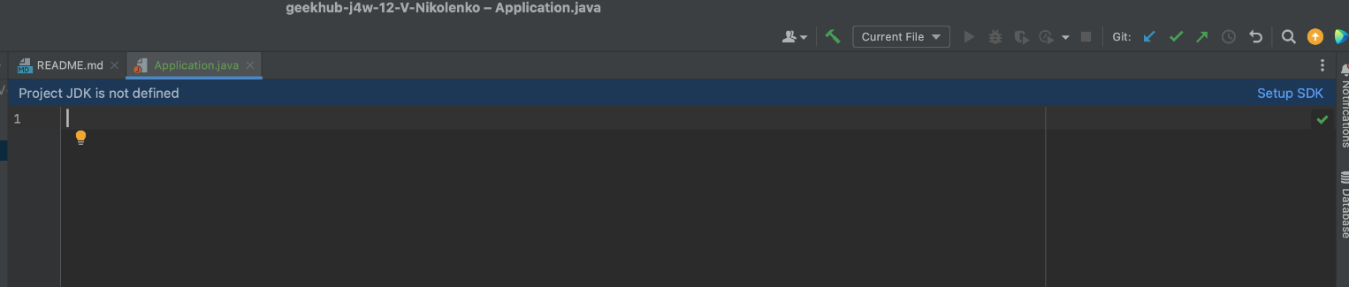
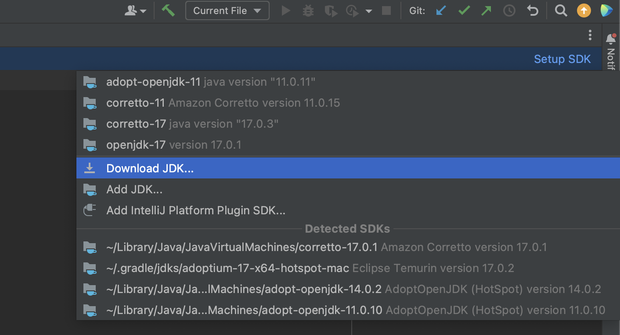
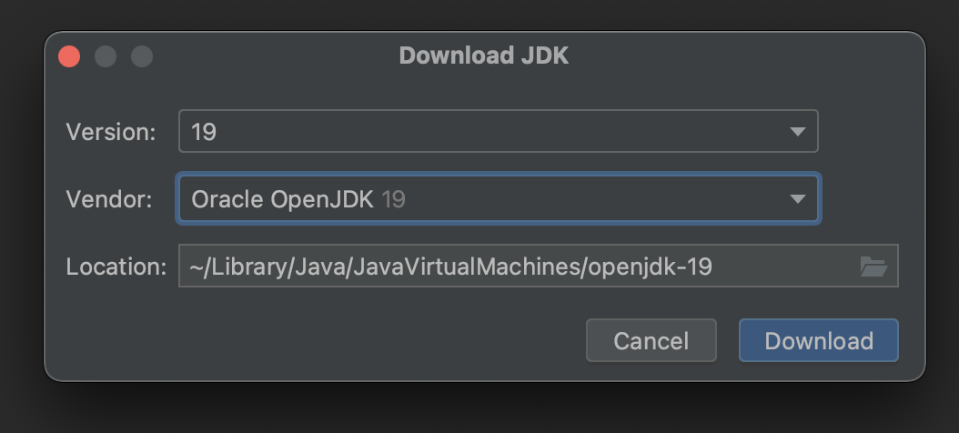
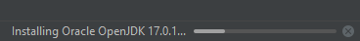
Setup SDK

Slide 41
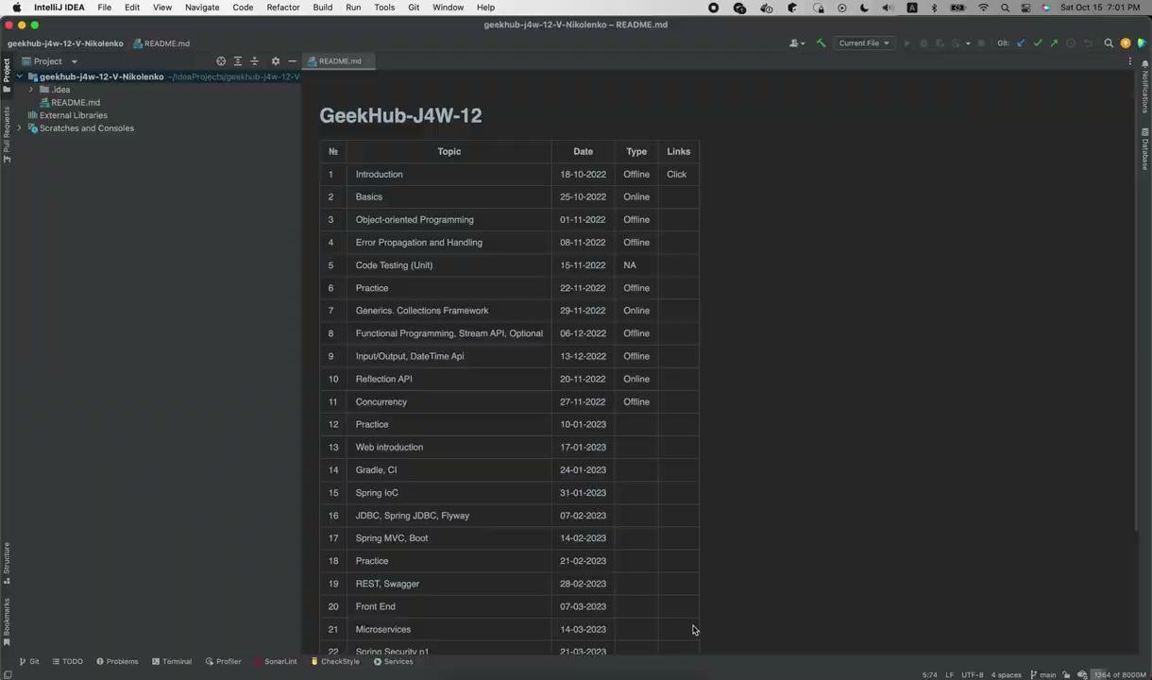
Setup JDK
Open project in IDEA
Choose “Project” tab
Add new JDK for IDEA
Choose JDK 17 for your project
Choose latest “Project language level”
Click “OK”

Slide 42
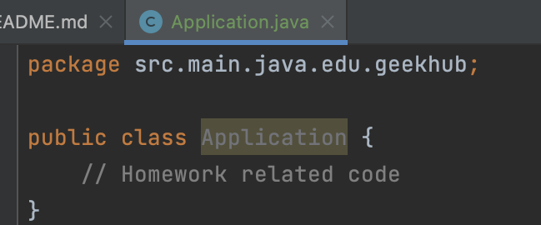
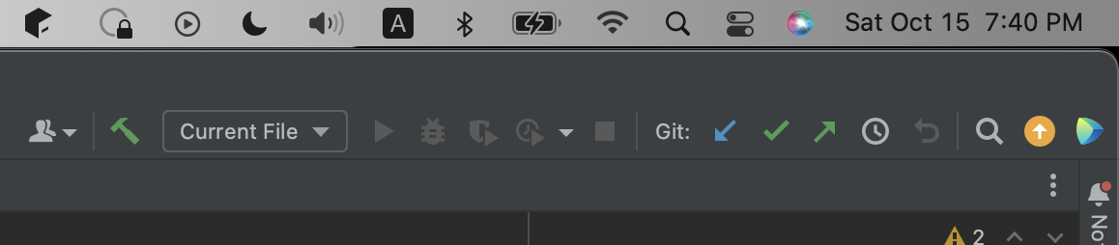
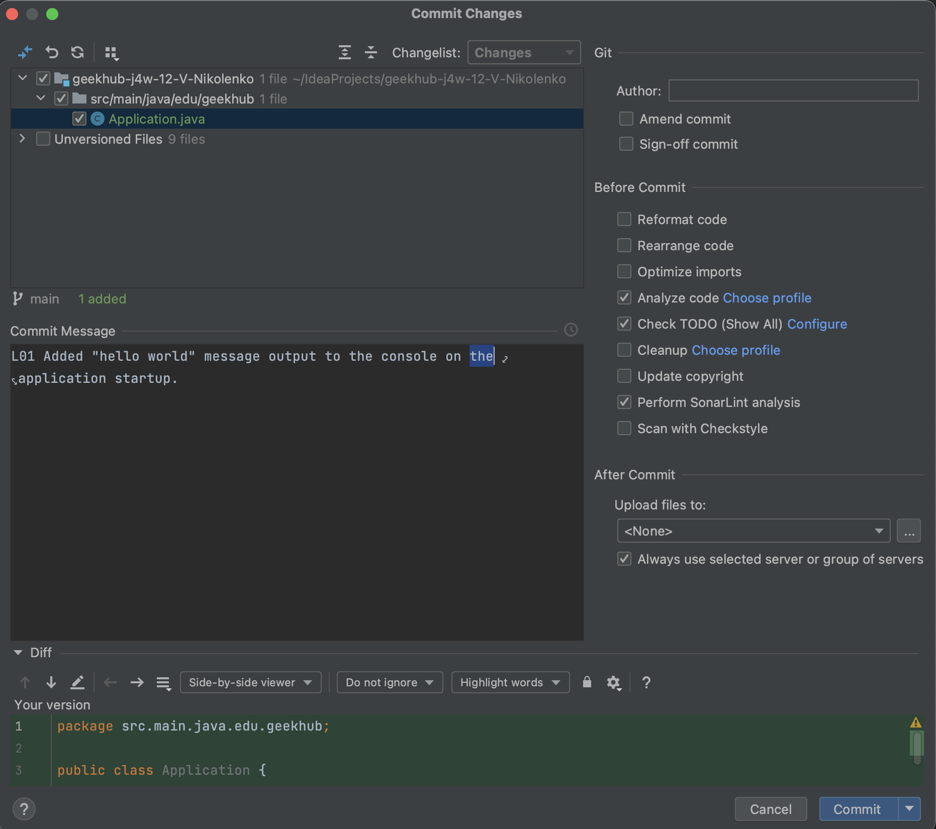
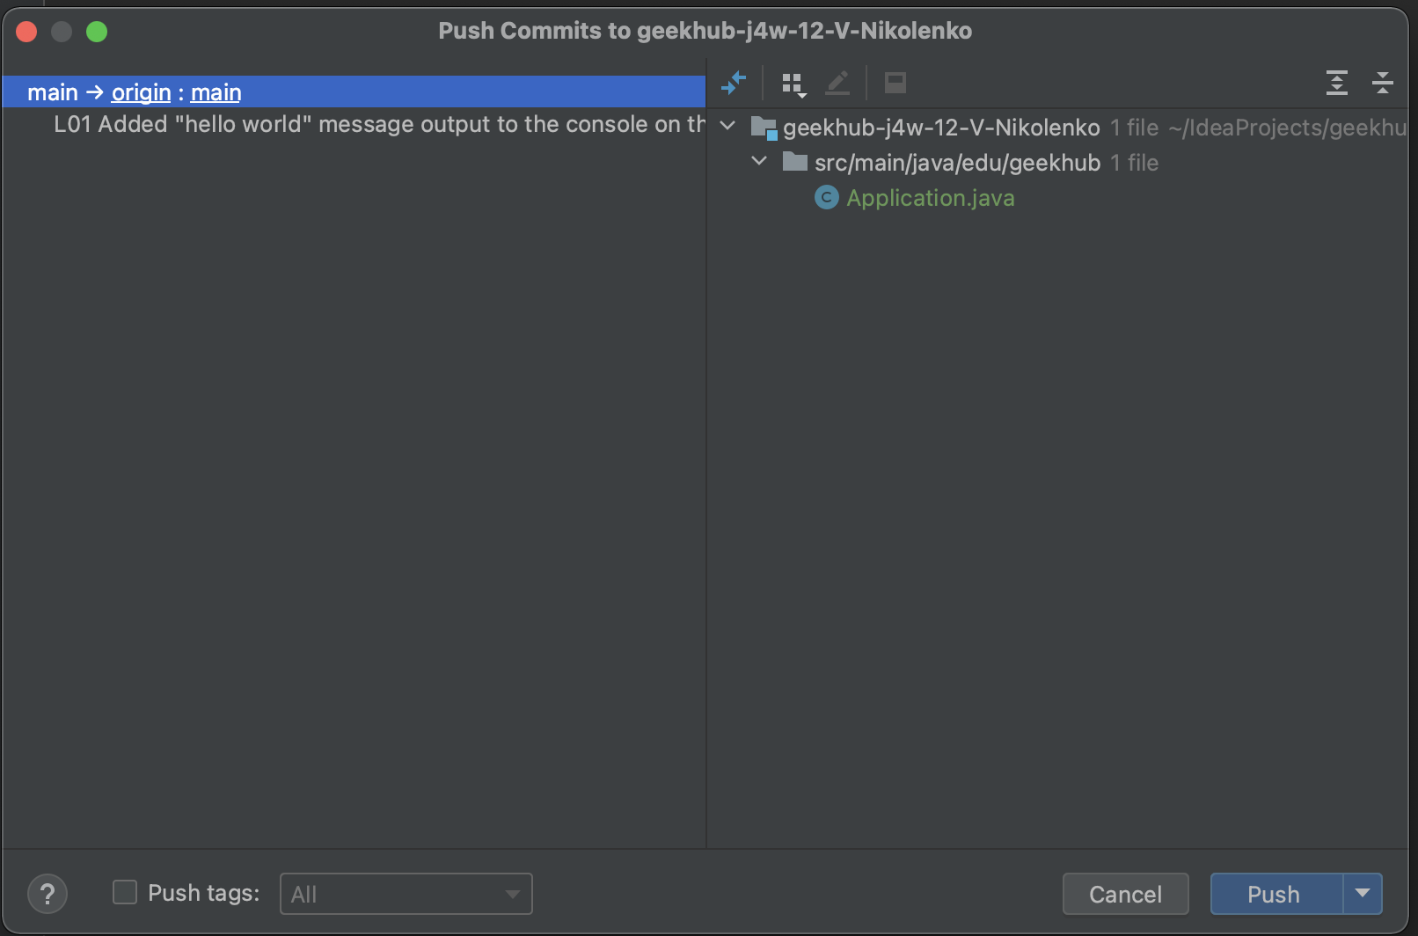
First Commit and Push to Git
You have made some changes, it’s time to commit and push
Press “Ctrl+K” to make commit
Choose files that should be committed
Type understandable and informative “L## Commit Message”
Check checkboxes: “Perform code analysis”, “Check TODO” and “Scan with CheckStyle”
Click “Commit”

Slide 43
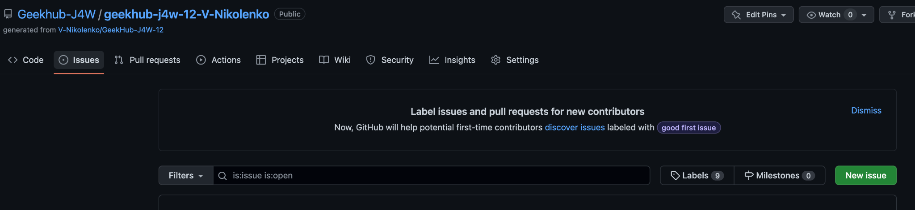
Create issue

Slide 44
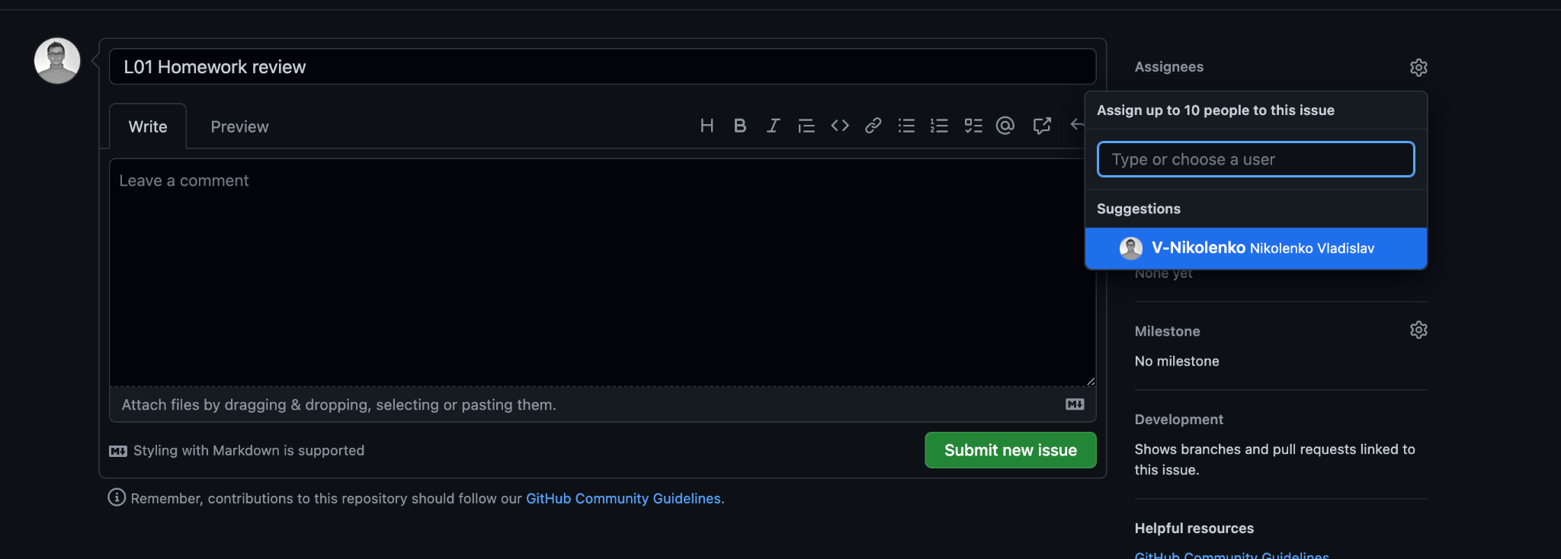
Create issue
Title: L## Homework Review
Assignee: Lector that was on lection

Slide 45

Homework
Required:
Download Intellij IDEA Community
Install Git on your computer
Create a new account on GitHub
Implement and push a Hello World greeting program
Create a GitHub issue with successful program execution. Assign it to lector
Install SonarLint plugin in your IDEA
Grant access to all mentors

Slide 46

Questions & Answers

Slide 47
Literature
Gamified git tutorial from Stanford
Pro Git
Git Setup

Slide 48
Thanks!
Find us in Slack:
@Mykhailo Semitkin
@Nazar Onishchenko
@Vadym Myroshnyk
@Vasya Rudas
@Vladyslav Nikolenko
@Yaroslav Brahinets

